Slide 1
Small Project 2
Implementasi React JS pada Website
Cilsy Fashionlution
Abdurrahman Arifin

Slide 2
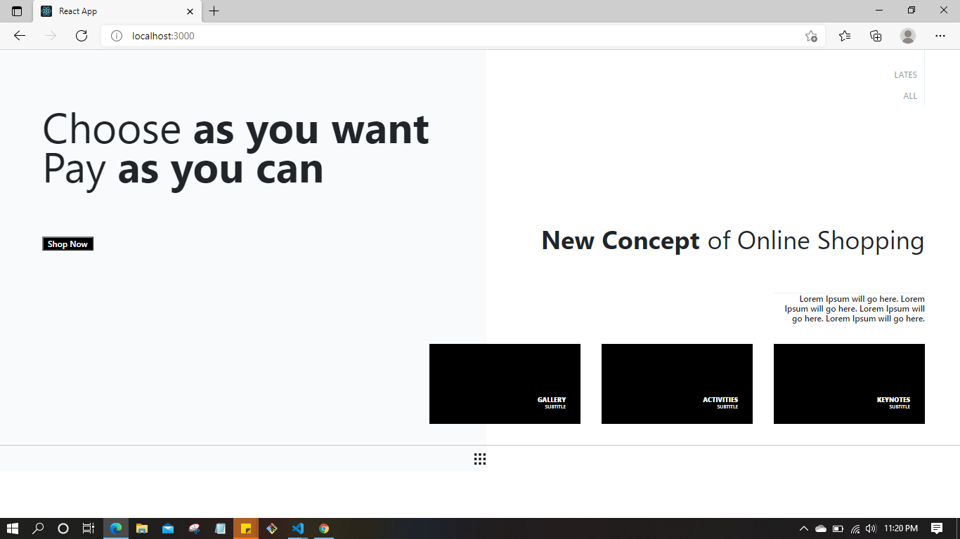
Main Page

Slide 3
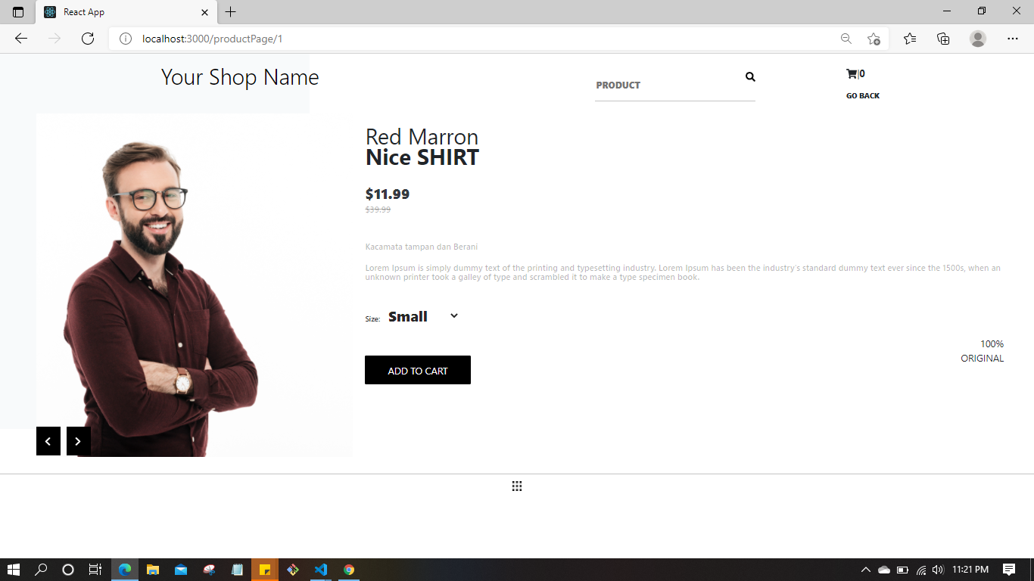
Product Page

Slide 4
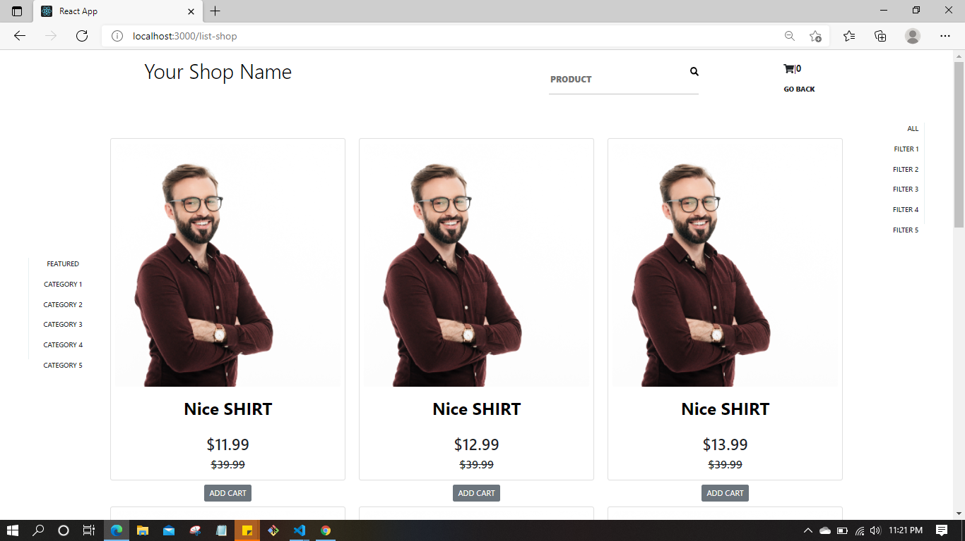
Shop Page

Slide 5
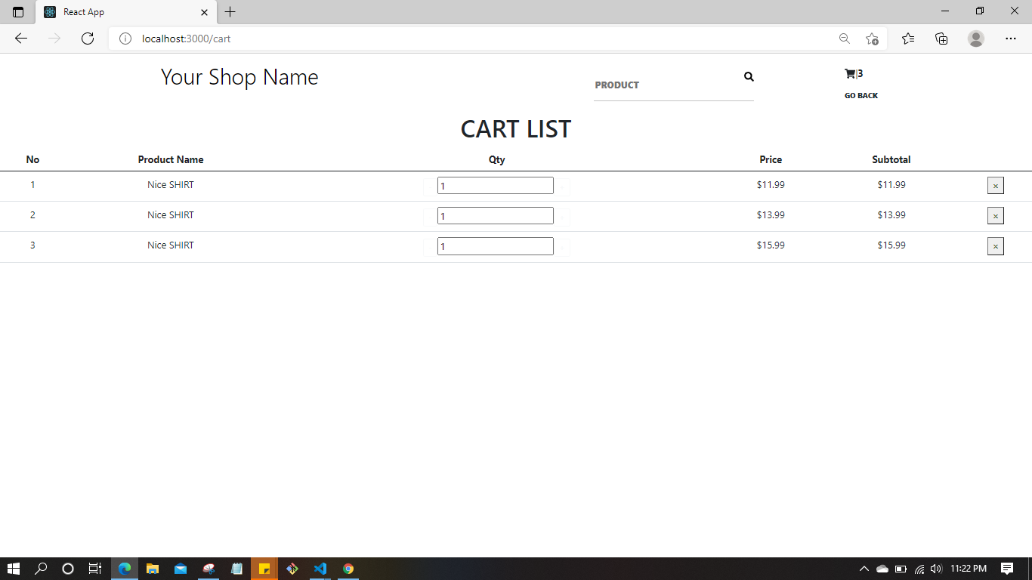
Cart page

Slide 6
Terima kasih….

